Slide 1
Traveler’s stories
УМК Spotlight 10

Slide 2
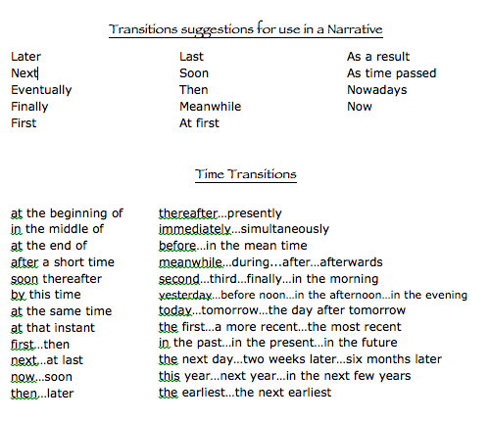
https://writingashortstory.wikispaces.com/Transition+Words

Slide 3
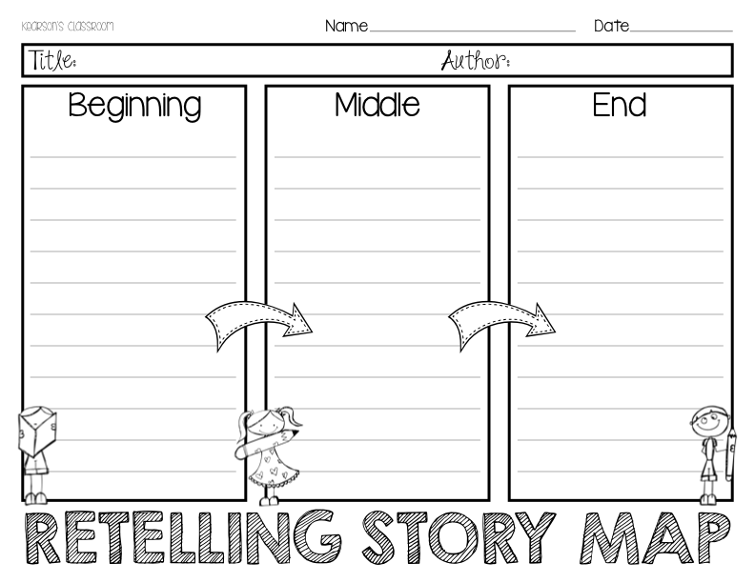
https://ru.pinterest.com/jsagnes/writing-bme/

Slide 4
Полезные ссылки
http://library.bcu.ac.uk/learner/writingguides/1.33.htm
http://www.english-at-home.com/speaking/telling-a-story/

